Slide 1
Deep Learning
ΜΠΛΟΥΤΣΟΣ ΚΩΝΣΤΑΝΤΙΝΟΣ ΜΤΝ2017

Slide 2
Agenda
Problem state
Data
Data Pre processing
Results
Next steps

Slide 3
Problem State
Product Sales using Deep Learning
A Deep learning approach to predict product’s sales based on sales data and Marketing Mix elements.
The focus of this exercise is on Retail data, so we try to identify future demand of a product

Slide 4
Data
29
Numeric
17
Categorical
For the purpose of the analysis we have used data from Kaggle.
Sales data with both numeric and categorical data as features
Continues dependent variable describing product sales
Week
Time
Volume
Value
Price per Volume
Price per Unit
BasePrice
Temporar Price Reduction
ACV_Weighted
Distribution_Weighted
ACV Cumulated Weighted Distribution (SKU) VOL
TPR_PromoCalendar
TPR_PromoCalendar Dummy
PM_multibuy 2+1
PM_60% for second
PM_TPR
PM_multibuy 1+1
leaflets_seasonal
leaflets_standard
Cashier
Tailor made name
Tailor made name Dummy
Tailor made name Football
Tailor made name Power of One
Tailor made name Power of One 2
Tailor made amount
Secondary display counts
Secondary display counts Dummy
WeeklyCategoryVolume
IsHoliday
IsChristmas/NewYear
IsEaster
IsSummer
Category_Category 2
Category_Category 3
Category_Category 4
Buckets_Of_Size_2_0 - 100 GR
Buckets_Of_Size_2_0 - 25 GR
Buckets_Of_Size_2_0 - 50 GR
Buckets_Of_Size_2_100 - 250 GR
Buckets_Of_Size_2_201 - 300 GR
Buckets_Of_Size_2_25 - 55 GR
Buckets_Of_Size_2_50-200GR
Buckets_Of_Size_2_>= 250 GR
Buckets_Of_Size_2_>=300 GR
Buckets_Of_Size_2_>=55 GR
2
#Years of data
Input also from
Competition
(other products in the category)

Slide 5
Data Pre processing
Transform categorical variables to binary with one-hot encoding
Create train/control dataset for model validation (train set is 80% randomly selected from the full dataset)
Descriptive analysis for data (both categorical and continuous data)

Slide 6
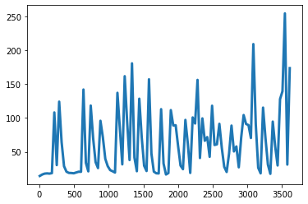
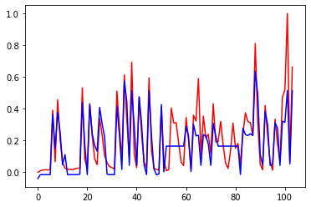
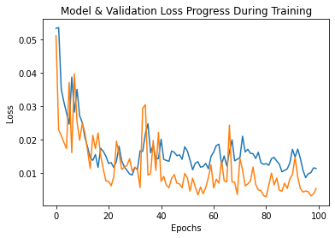
Results for one product
Product Sales
Actual vs. Fit Sales
RMSE= 0.103
MSE= 0.011
MAE= 0.08
R_Sqaure= 74%

Slide 7
Next steps
Augment the analysis with more data
Loyalty data
Stock data
Competition data
Marketing (ATL: TV. Radio, Internet)
Social-demographic data |loyalty data
Customer Segmentation

